Slide 1

Basic Electrical Engineering (BEEE101L)
Presented By
Dr. Maddela Chinna Obaiah
Assistant Professor (Sr)
School of Electrical Engineering

Slide 2
Module 1: DC circuits
Basic circuit elements and sources
Ohms law
Kirchhoff ’s laws
Series and parallel connection of circuit elements
Node Voltage Analysis, Mesh Current Analysis
Thevenin's and Maximum power transfer theorem

Slide 3
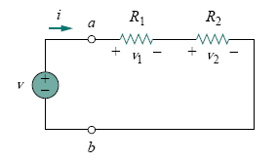
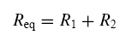
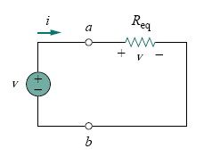
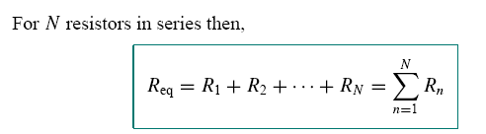
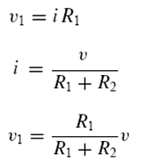
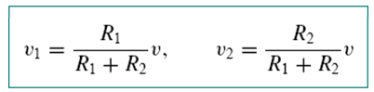
SERIES RESISTORS AND VOLTAGE DIVISION
The two resistors are in series, since the same current i flows in both of them. Applying Ohm’s law to each of the resistors, we obtain
The larger the resistance, the larger the voltage drop. This is called the principle of voltage division.

Slide 5
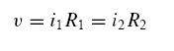
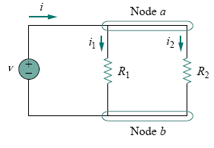
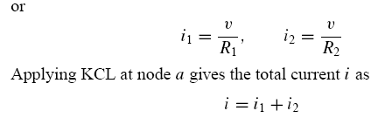
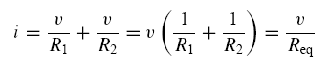
PARALLEL RESISTORS AND CURRENT DIVISION
Two resistors are connected in parallel and therefore have the same voltage across them. From Ohm’s law,
Circuit is known as a current divider.

Slide 6
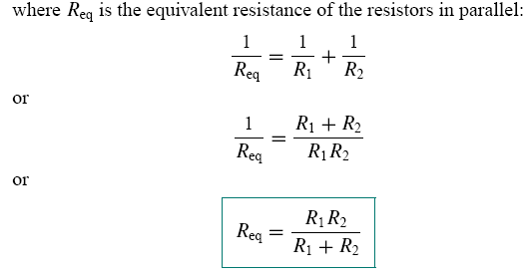
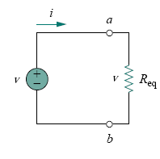
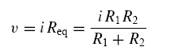
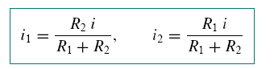
This is known as the principle of current division.

Slide 7
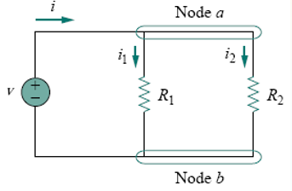
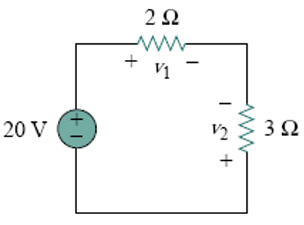
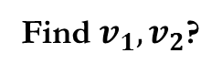
Find $i_{1}, i_{2},$where $v=10V, R_{1}=4Ω,R_{2}=8Ω$?
Find $v_{1}, v_{2}$?

Slide 8
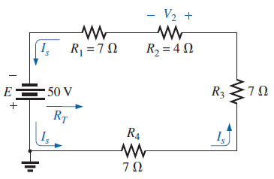
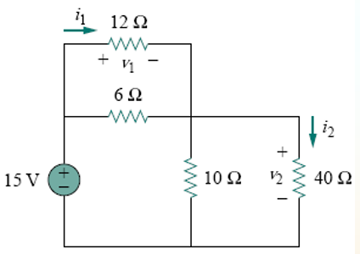
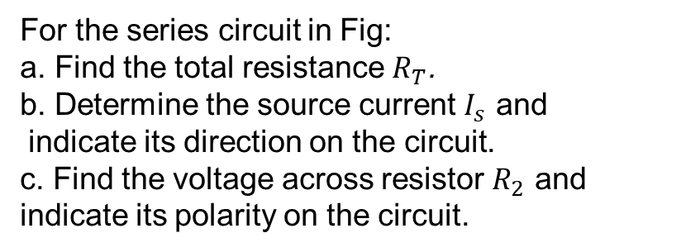
For the series circuit in Fig:
a. Find the total resistance $R_{T}$.
b. Determine the source current $I_{s}$ and
indicate its direction on the circuit.
c. Find the voltage across resistor $R_{2}$ and indicate its polarity on the circuit.
Find v₁ and v₂ in the circuit. Also calculate i₁ and i₂ and the power dissipated in the 12Ω and 40Ω resistors.

Slide 10
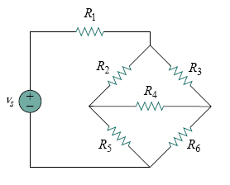
parallel or series?

Slide 11
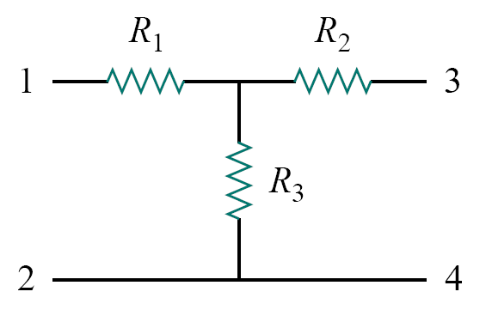
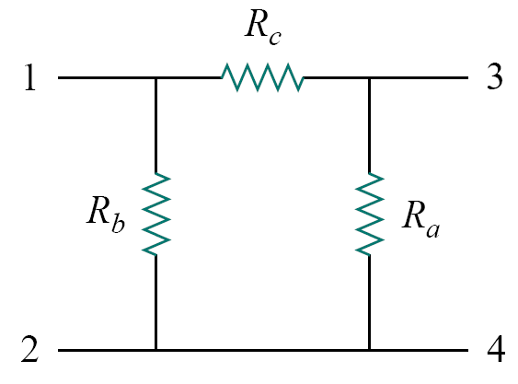
WYE-DELTA TRANSFORMATIONS

Slide 12
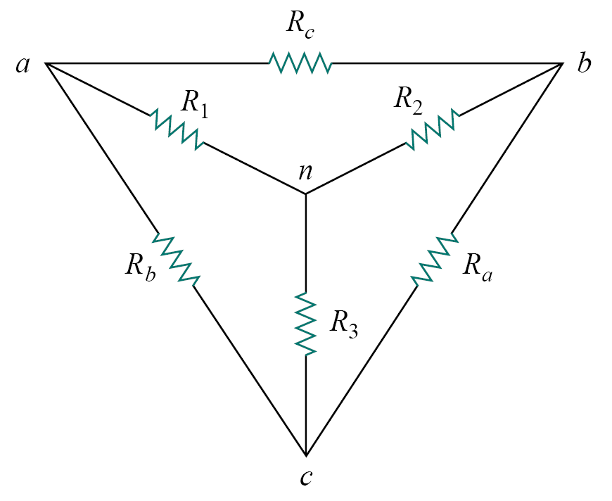
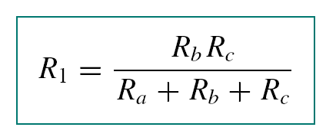
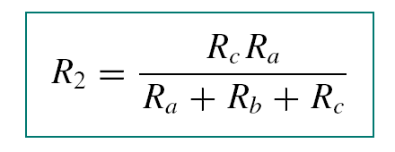
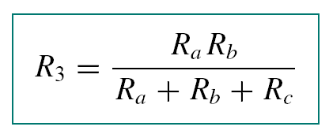
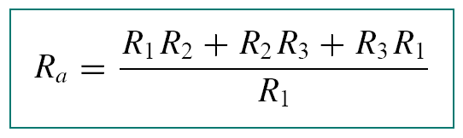
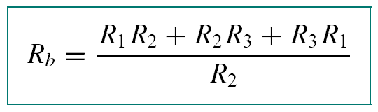
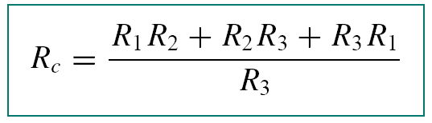
Delta to Wye Conversion
Wye to Delta Conversion

Slide 13
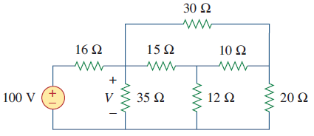
Problem: Determine V in the circuit of fig using Wye-Delta Transformation Technique.
V = 42.18 volts

Slide 16
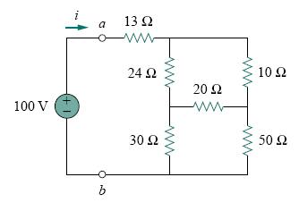
Problem: For the bridge network, find Rab using Wye-Delta Transformation and i.
Answer: 40 , 2.5 A.
RL = 20 Ω V_{th} = 19.08 V R_{th} = R_{N} = 22.35 Ω I_{N} = 0.85 Amp

Slide 18
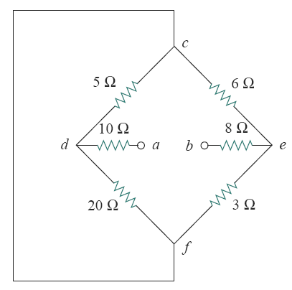
Problem: Find Equivalent Resistance across terminals a, b?
Ans: Rab = 24 Ω

Slide 20
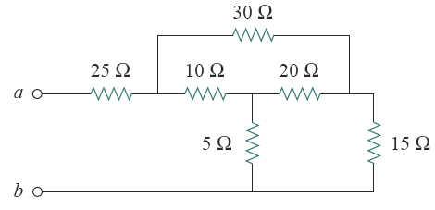
Problem: Determine equivalent resistance in the circuit of fig using Wye-Delta Transformation Technique.
Ans: Rab = 36.25 Ω

Slide 22
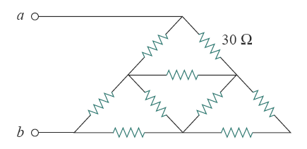
Problem: Find Rab using Wye-Delta Transformation
Rab = 33.3 Ω
All resistors have a value of 30 Ω

Slide 24
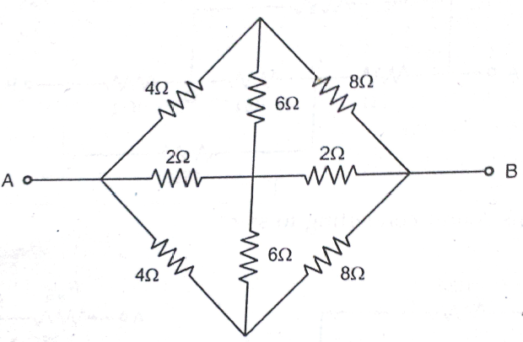
Problem: Find equivalent resistance across AB using Wye-Delta Transformation as shown in Figure
Ans: R_{eq} = 2.37 ohm

